Slide 1
Introduction to Relational Model - Constraints

Slide 2
General Guideline
© (2021) ABES Engineering College.
This document contains valuable confidential and proprietary information of ABESEC. Such confidential and proprietary information includes, amongst others, proprietary intellectual property which can be legally protected and commercialized. Such information is furnished herein for training purposes only. Except with the express prior written permission of ABESEC, this document and the information contained herein may not be published, disclosed, or used for any other purpose.

Slide 3
Module Objective
To describe the structure of Relational Model .
To understand database schema , relational model objects and characteristics of relations
To discuss different keys in relational database like Super Key , Candidate key ,Primary Key , Composite Key , Secondary Key or Alternate Key , Surrogate Key , Foreign and Unique Key
To explain different constraints like schema based or integrity , entity integrity or key , Referential integrity and domain constraints
To discuss SMS Case study with all constraints
To understand basic concepts of SQL

Slide 4
Session Plan
Constraints
Integrity Constraints
Entity Integrity Constraints
Referential Integrity Constraints
Domain Constraints

Slide 5
Constraints

Slide 6
Constraints
A relational database is a collection of relations. These relations store data about a business or a business process. Functional users or business managers define the rules that must be applied to this data before storing it in the database. For example, in our SMS case study,
Each student must have a roll number which must be unique in the records maintaining student data.
No student in a department can work on more than one mini-project.
A student can belong to only one department, etc.

Slide 7
Constraints
The business rules or restrictions which are enforced on data being stored in a relation are called Constraints. These constraints ensure that data stored in relations will be valid.
Note: Even if a single column of the record being entered into the relation fails a constraint, then the entire record is rejected and not stored in a relation.

Slide 8
Categories of Constraints
Constraints on databases are divided into three main categories:
Inherent model-based constraints or implicit constraints
Schema-based constraints or explicit constraints or integrity constraints
Application-based constraints

Slide 9
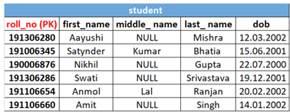
Inherent model-based constraints or implicit constraints
The constraints that are implicit in a data model are called inherent model-based constraints. These constraints are:
Ordering of tuples in a relation: A relation is not sensitive to the ordering of tuples.
Values and NULLs in the Tuples:
a) Multi-valued attributes are not allowed.
b) To represent the values of attributes that may be unknown or may not apply to a tuple. A special value, called NULL, is used .
Example :A student does not have middle name in the student relation , it will represent by NULL

Slide 10
Schema-based constraints or explicit constraints or Integrity constraints
Integrity constraints are used to ensure accuracy and consistency of the data in a relational database. These constraints ensure that changes made to the database by authorized users do not result in a loss of data consistency. Thus, integrity constraints guard against accidental damage to the database.
These are further categorized as:
Entity Integrity constraint or Key constraint
Referential Integrity constraint
Domain Integrity constraints
Null constraint
Unique constraint
Check constraint
Default constraint

Slide 11
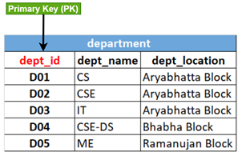
Entity Integrity Constraint or Key Constraint
Entity integrity constraint is a major component of overall data integrity, and it ensures that there are no duplicate tuples in a relation.
Entity integrity constraint is based on the Primary Key (PK).
The primary key of a relation ensures there are no duplicate tuples in a relation.
The value of a primary key is unique and not null.
For example, in Figure, (dept_id) is the primary key of department relation. (dept_id) will be unique and not null for all tuples of the department relation.

Slide 12
Can you Answer this question
Q: Which of the constraint can be enforced one per table?
Primary key constraint
Not Null constraint
Foreign Key constraint
Check constraint

Slide 13
Can you Answer this question
Q: Which of the constraint can be enforced one per table?
Primary key constraint
Not Null constraint
Foreign Key constraint
Check constraint

Slide 14
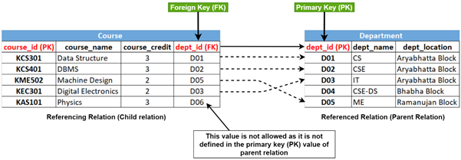
Referential Integrity Constraints
They are based on the concept of Foreign Key.
If a relation R2 has a foreign key attribute (FK) matching the primary key attribute (PK) of other relation R1, then every value of FK in R2 must either be equal to the value of PK in some tuple of R1 or the FK value must be null. R1 and R2 are not necessarily distinct (in the case of a recursive relationship)

Slide 15
Referential Integrity Constraints
For example, as shown in Figure , the department id attribute in the Course and department must be the same. Attribute (dept_id) in the course relation is referring to the primary key attribute (dept_id) of department relation. Thus the Course is called the referencing relation, and the department is the referenced relation. All values in (dept_id) of Course, relation satisfy the referential integrity constraint except the value D06 as it is not present in (dept_id) attribute in department relation. Referential integrity constraint will not allow D06 as a value for the foreign key (dept_id) in the course relation.

Slide 16
Can you Answer this question
Q: Which of the following can be addressed by enforcing a referential integrity constraint?
All phone numbers must include the area code
Certain fields are required (such as the email address, or phone number) before the record is accepted
Information on the customer must be known before anything can be sold to that customer
When entering an order quantity, the user must input a number and not some text

Slide 17
Can you Answer this question
Q: Which of the following can be addressed by enforcing a referential integrity constraint?
All phone numbers must include the area code
Certain fields are required (such as the email address, or phone number) before the record is accepted
Information on the customer must be known before anything can be sold to that customer
When entering an order quantity, the user must input a number and not some text

Slide 18
Domain constraint
Domain constraints specify the set of possible values that may be associated with an attribute.
A common method of specifying a domain for an attribute is to specify a data type from which the data values forming the domain are drawn.
Some of the most commonly used domain constraints:
Null constraint: It specifies whether null values are permitted for an attribute
Unique constraint: It is a rule that forbids duplicate values in one or more columns within a relation
Check constraint: It is defined on a column for specifying the range of values that can be inserted into it, using a predefined condition
Default constraint: It is defined to provide a default value to a column if no other value is provided while inserting a new record.

Slide 19
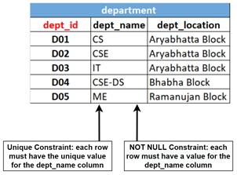
Null Constraint
It specifies whether null values are permitted for an attribute.
NOT NULL constraint makes sure that a column does not hold NULL value.
When we do not provide a value for a particular attribute (column) while inserting a record into a relation, it takes NULL value by default.
For example, if every department must have a valid, non-null value for the (dept_name) attribute, then the (dept_name) attribute for the department relation is constrained to be NOT NULL.
As shown in Figure , each tuple of department relation must have the value for the (dept_name) column as it cannot be left empty.

Slide 20
Unique Constraint
A unique constraint (also referred to as a unique key constraint) is a rule that forbids duplicate values in one or more columns within a relation.
This constraint is used to implement secondary or alternate keys.
However, attributes declared as unique are permitted to have null values unless they have been explicitly declared NOT NULL.
For example, as shown in Figure ,each row of Department relation must have the unique value for the (dept_name) column.

Slide 21
Check Constraint
A check constraint is defined on a column for specifying the range of values that can be inserted into it, using a predefined condition.
When this constraint is set on a column, it ensures that the specified column must have the value falling in the specified range.
Example 1 - We understand that the salary of the faculty cannot be a negative value; it must always be greater than 0. So, in faculty relation (salary), the salary of the faculty will have a check constraint, i.e., the constraint will ensure that the value of (salary) will be greater than zero always.
Example 2 - In student relation, the gender can be Female, Male, or Trans. So, (gender) will have a check constraint that will ensure that the value inserted in each row must be any one of (Female, Male, or Trans).

Slide 22
Default Constraint
The default constraint is defined to provide a default value to a column if no other value is provided while inserting a new record.
For example, the default value for the (status) column of Research Project relation can be taken as "Ongoing".

Slide 23
Application-based constraints
Constraints that cannot be directly expressed in the schemas of the data model and hence must be expressed and enforced by the application programs are called application-based constraints.
For example, a student can take a maximum of 25 credits in a semester.

Slide 24
Can you Answer this question
Q: Point out the correct statement.
CHECK constraints enforce domain integrity
UNIQUE constraints enforce the uniqueness of the values in a set of columns
In a UNIQUE constraint, no two rows in the table can have the same value for the columns
All

Slide 25
Can you Answer this question
Q: Point out the correct statement.
CHECK constraints enforce domain integrity
UNIQUE constraints enforce the uniqueness of the values in a set of columns
In a UNIQUE constraint, no two rows in the table can have the same value for the columns
All

Slide 26
Can you Answer this question
Q: Which of the following types of tables constraints will prevent the entry of duplicate rows?
Primary keys
Foreign keys
Unique keys
Candidate keys

Slide 27
Can you Answer this question
Q: Which of the following types of tables constraints will prevent the entry of duplicate rows?
Primary keys
Foreign keys
Unique keys
Candidate keys

Slide 28
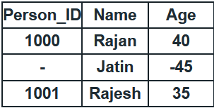
Can you Answer this question
Q: Consider the database table "Persons" having person_ID as the primary key:
What are the constraints violated by the above table?
Referential Integrity
Relationship Integrity
Referential and Domain Integrity
Entity and Domain Integrity

Slide 29
Can you Answer this question
Q: Consider the database table "Persons" having person_ID as the primary key:
What are the constraints violated by the above table?
Referential Integrity
Relationship Integrity
Referential and Domain Integrity
Entity and Domain Integrity

Slide 30
Case Study Design with Complete Constraints
Data Dictionary:
A data dictionary is a set of information used by database administrators to describe the structure of a relational database by defining the data items (attributes/column name), their types, format, constraints, and relationship between the relational tables.
A data dictionary contains data about the relational tables, which actually contains the data. It is also called "data about data" or metadata.
Data Dictionary provides the metadata about each relational table in the database, e.g., data item or column name, suggested data type for that column, maximum allowed column width, data format to be stored in on the disc, constraints applied on column level and relational table level, a brief description of the column and example representing actual data item to be filled in the column.

Slide 31
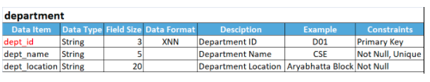
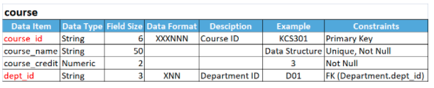
Case Study Design with Complete Constraints

Slide 32
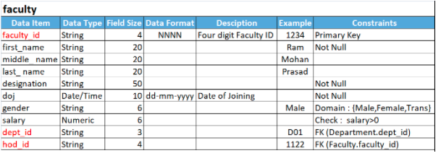
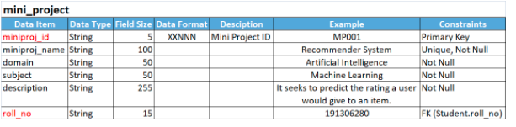
Case Study Design with Complete Constraints

Slide 33
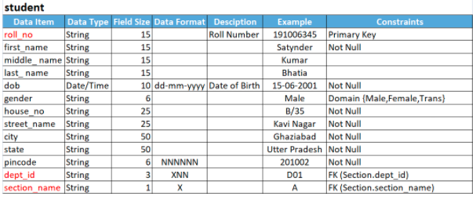
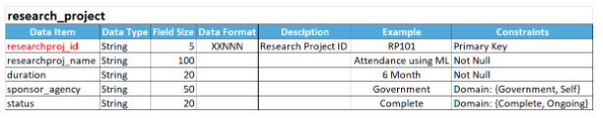
Case Study Design with Complete Constraints

Slide 34
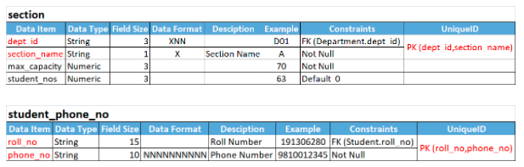

Case Study Design with Complete Constraints

Slide 35
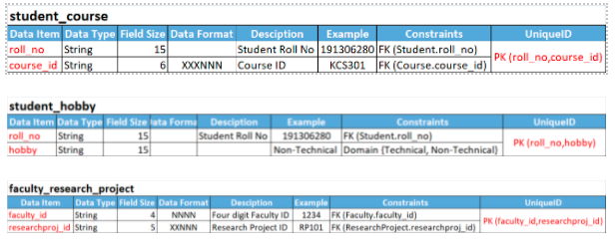
Case Study Design with Complete Constraints

Slide 36
Review Questions
What Are Constraints in relational model?
What are the different levels of data integrity?
Explain different constraints to maintain data integrity?
If we need to restrict column "Name" to take only alphabets, what kind of constraint we need to apply and how?

Slide 37
Thank You

